Slide 1
Top Trumps using PokéAPI

Slide 2
Code Pt. 1/3
#generate a random pokemon
def gen_pokemon():
n = random.randint(1, 151)
url = 'https://pokeapi.co/api/v2/pokemon/{}/'.format(n)
response = requests.get(url)
pokemon = response.json()
stats = pokemon['stats']
return {
'id': pokemon['id'],
'name': pokemon['name'],
'hp': stats[0]['base_stat'],
'attack': stats[1]['base_stat'],
'defense': stats[2]['base_stat']
}
# display pokemon dictionary in a readable way
def disp_pokemon(dict):
print('#{}- {}'.format(dict['id'],dict['name'].capitalize()))
print('HP:{} Attack:{} Defense:{}'.format(dict['hp'],dict['attack'],dict['defense']))
#for hard mode (stats not visible)
def disp_pokemon_h(dict):
print('#{}- {}'.format(dict['id'],dict['name'].capitalize()))
#open file in eXclusive mode; catch error if it exists
try:
with open('highscore.txt', 'x') as f:
f.write('0')
except FileExistsError:
pass # nothing is done

Slide 3
Code Pt. 2/3
#team and difficulty selection
def poke_choose():
p = int(input())
while p<1 or p>6:
p = int(input("Please choose a number from 1 to 6:"))
return p
all_choices = []
my_team = []
flag = 0
print("Welcome to TOP TRUMPS with Pokémon!") difficulty = input("\nPlease select a difficulty: [easy/hard]")
while flag == 0:
if difficulty == "easy" or difficulty == "hard":
flag = 1
else:
difficulty = input("Please choose between 'easy' or 'hard' mode:")
print("\nSelect 3 different Pokémon for your team. Your choices are:")
for i in range(6):
all_choices.append(gen_pokemon())
if difficulty == 'easy':
for i in range(6):
print('{}--->'.format(i+1))
disp_pokemon(all_choices[i])
if difficulty == 'hard':
for i in range(6):
print('{}--->'.format(i+1))
disp_pokemon_h(all_choices[i])
print('\nChoose a Pokémon: [1-6]')
p1 = poke_choose()
print('\nChoose a second Pokémon: [1-6]')
p2 = poke_choose()
while p2 == p1:
print("You've already chosen that Pokémon. Please enter a different number: [1-6]")
p2 = poke_choose()
print('\nChoose a third Pokémon: [1-6]')
p3 = poke_choose()
while p3 == p1 or p3 == p2:
print("You've already chosen that Pokémon. Please enter a different number: [1-6]")
p3 = poke_choose()
my_team.append(all_choices[p1-1])
my_team.append(all_choices[p2-1])
my_team.append(all_choices[p3-1])

Slide 4
Code Pt. 3/3
#best of 3 battles
count = 0
score = 0
for i in range(3):
if difficulty == 'easy':
print("Your Pokémon:")
disp_pokemon(my_team[i])
print("\nBattle #{}: Which stat will you choose? [hp/attack/defense]".format(i+1))
flag = 0
choice = input()
while flag == 0:
if choice == "hp" or choice == "attack" or choice == "defense":
flag = 1
else:
choice = input("Please enter a valid stat: [hp/attack/defense]")
opp_pokemon = gen_pokemon()
if difficulty == 'hard':
print("\nYour Pokémon:")
disp_pokemon(my_team[i])
print("\nOpponent's Pokémon:")
disp_pokemon(opp_pokemon)
if my_team[i][choice] > opp_pokemon[choice]:
print("\nYou win!")
count += 1
score += (my_team[i][choice] - opp_pokemon[choice])*100 # difference of winning stat
elif my_team[i][choice] == opp_pokemon[choice]:
print("\nDraw.\n")
else:
print("\nYou lose...\n")
print("\nYou won {}/3 battle(s)".format(count))
if count >=2:
print("Victory! Great job.")
else:
print("You lose... Better luck next time.")
#check If high score from file print("\nScore: {}".format(score))
with open('highscore.txt', 'r') as f:
old_score = int(f.read())
if score > old_score:
print("NEW HIGH SCORE!")
with open('highscore.txt', 'w') as f:
f.write(str(score))

Slide 5
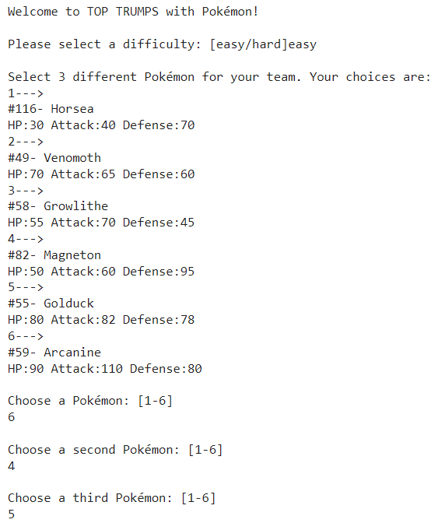
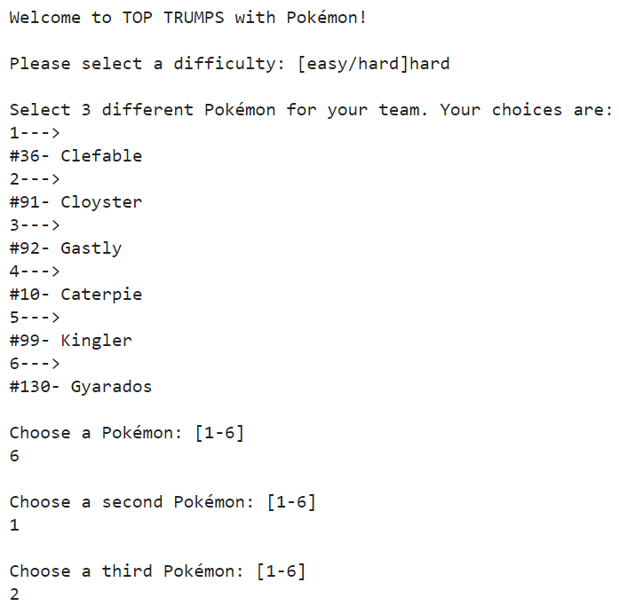
Output - Team Selection
Easy difficulty level
Hard difficulty level (stats not visible)

Slide 6
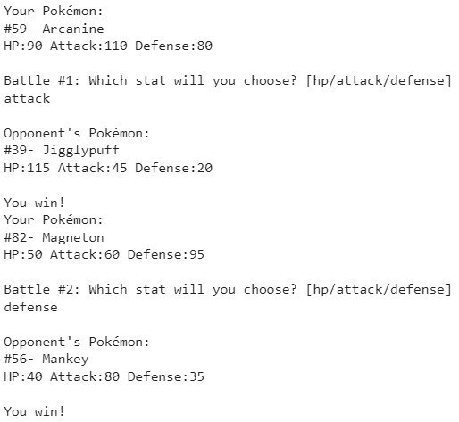
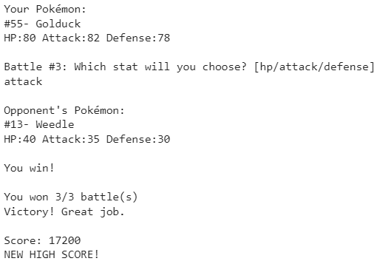
Output – Easy difficulty level

Slide 7
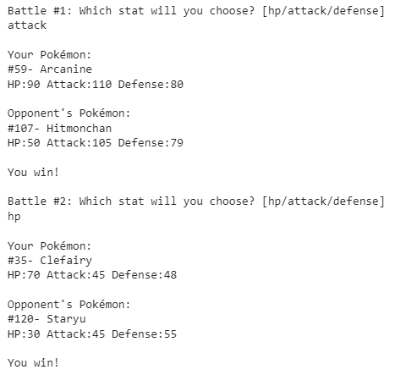
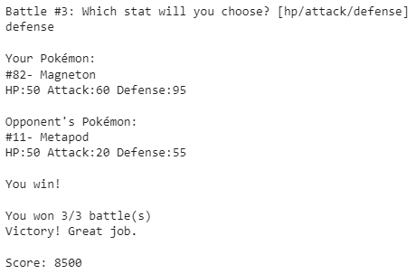
Output – Hard difficulty level

